Slide 1
Welcome to the
Open-E Certified Engineer Training
Verona – February 12 / 13, 2013
Notes:
Welcome
Before we start with our training short intro
Most of you know who Open-E is and what we do / few things that are not on the website

Slide 2
Agenda
OECE Training - Day 1
Welcome and Introduction
Introduction to Open-E DSS V7
Installing Open-E DSS V7 (as a VM, RAID and Flash Stick)
Auto Failover - Active-Active with Open-E DSS V7 (iSCSI) and Active-Passive with Open-E DSS V6 (NFS)
Data Replication
Snapshots and Backup
Multipath vs. Bonding & MPIO with VMware and Windows
Understanding Logs
Auto Failover Active-Active with Open-E DSS V7 (iSCSI), Zero-single-Point-of-Failure setup and best practices

Slide 3
Welcome
and Introduction

Slide 4
Company
Founded: September 9, 1998
Locations: USA (Headquarter)
Germany (Sales, Marketing, Technical Support, Administration)
Poland, Ukraine (Programmers)
Japan (Sales)
China (Sales)
Team: 40+ Engineers / Programmers
15+ Sales, Marketing, Technical Support, Administration
Partnerships: Intel, LSI, Supermicro, Adaptec, AMD, QLogic, VMware,
Citrix, Solarflare, Symantec…
Investor: Openview Venture Partners
Channel: 500+ certified Partners
15.000+ Customers in 100+ Countries
Notes:
14th year on the market
HQ in US => Venture Capital company invested in OE => helped us to accelerate development
Focus on engineering
Hard- and software companies as technology partners

Slide 5
What is Open-E about?
Open-E, Inc. is a pioneering leader and developer of
IP-based storage management software which is aimed
at the SMB and SME markets.
Global business with customers in over 100 countries
Always one step ahead with modern development technologies
Using best practices in efficient project management
Reliable business partner of industry-leading IT companies
Qualified and international team of professionals
Notes:
- To sum

Slide 6
How does Open-E‘s development work?
Since 2006 new project management and development
Technologies have been implemented
Agile Development with SCRUM
Continuous Integration
Quality Assurance through looped testing
Open-E Dedicated Test System with over 2.000 automated tests
Code Revisioning
Result: Focus on continuous quality improvement!
Notes:
SCRUM: management of development is easy with just a few developers, with more it can be difficult / that‘s why SCRUM / ability to always keep control of deveolpment / transparency, flexibility and responsibility of every engineer
Continuous Integration: invested lots of time and money / changes can be implemented continuously and much faster / before: 8 hours / now 10 minutes to create a new software build
Quality Assurance: programming of new functionality starts with writing a test / then starts programming / Programmer > Acceptance tests > Tester in Dev. Team > QA testing (2 months) > Beta Testers > Release Candidate > Release
ODTS: especially developed for Open-E / every code mistake will be detected
Code Revisioning: documentation of every code line / double-checking by developers / transparency of code

Slide 7
Credibility
Over 27,000 installations in Fortune 500 organization world-wide (over 100 countries)
Numerous industry awards and recognition from
SearchStorage.de, PC Professional, Storage Awards, Network Computing, Tom's Hardware, PC Pro Labs, Computer Partner, and more…

Slide 8
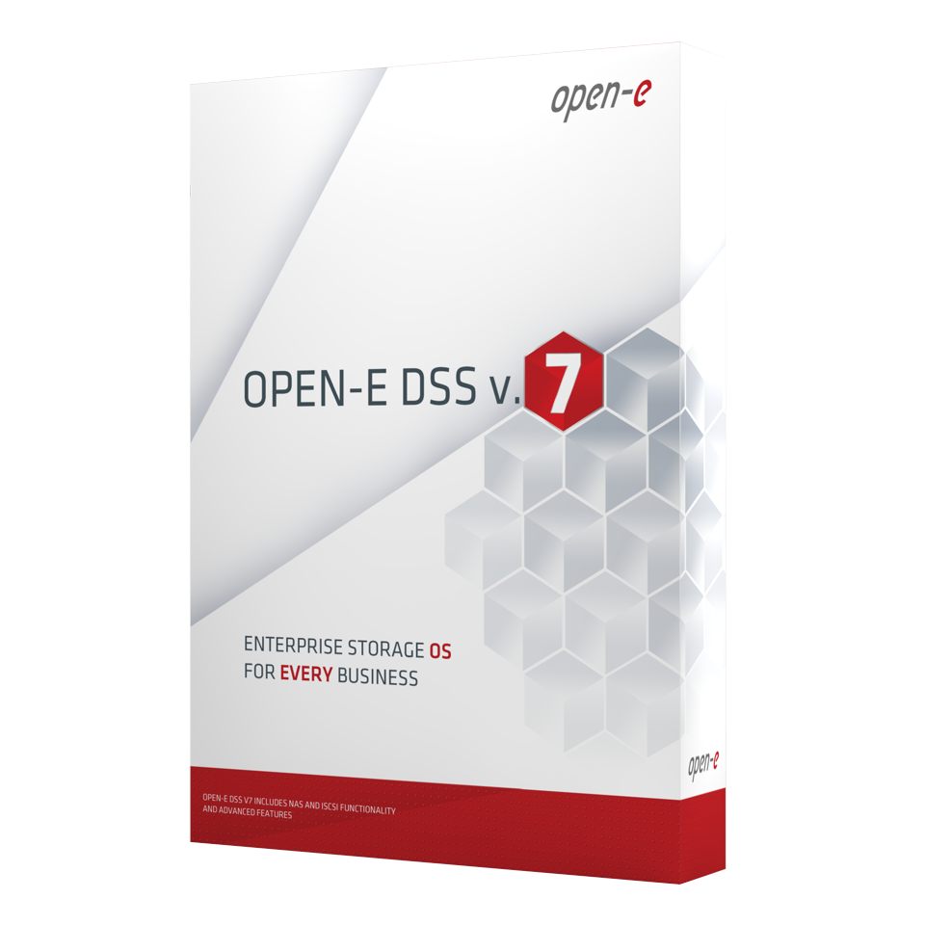
Open-E‘s Product
Today Open-E is just a One Product Company
Open-E DSS
(Data Storage Software) V7

Slide 9
Best Solution
There are five main reasons to consider Open-E
A stable, robust storage application
Provides excellent compatibility with industry standards
It is the easiest-to-use and manage
Best supported in hardware and service
The leader in the price performance ratio
Notes:
Based on Linux
Technology partners / Hardware Compatibility List
Will see for yourself
Maybe you already were in contact one of Todd or one of our support engineers
Most of our competitors only seem affordable until you purchase all the add-ons / with us you get all functionalities at once for a reasonable price

Slide 10
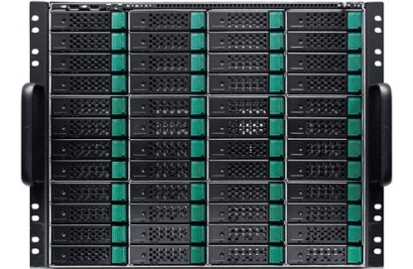
What is the Software for?
You can use Open-E DSS for a variety of setups
Data Storage Software
Single Node
NAS Filer
iSCSI Target
Backup
Storage Consolidation
Cluster
Continous Data Protection
Disaster Recovery
Cloud Storage
Storage for Virtualization

Slide 11
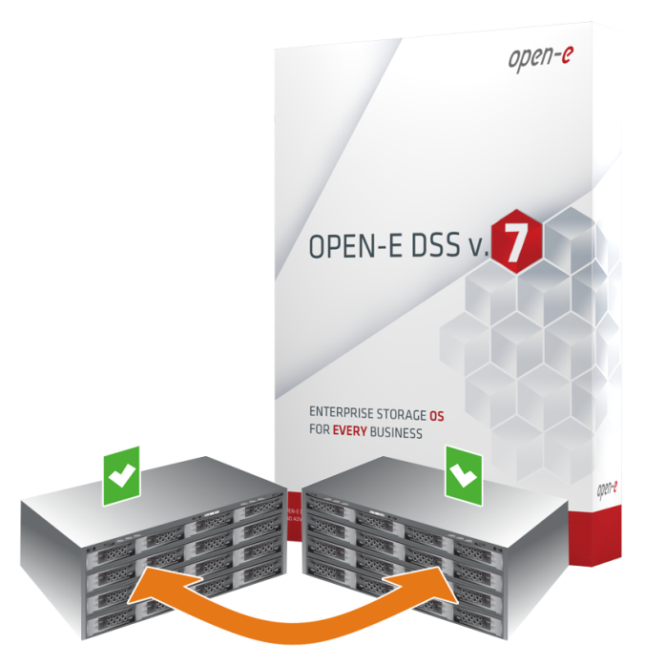
What‘s new?
Active-Active Failover for iSCSI Volumes
Doubles your overall performance
Increases read and write performance by 100%
Single Point of Failure is eliminated
Includes self-validation of the system
Speeds up networking connectivity
Enhances cluster security
Cuts Active-Active switching time in half compared to Active-Passive
Fully utilizes all processing power on both cluster nodes

Slide 12
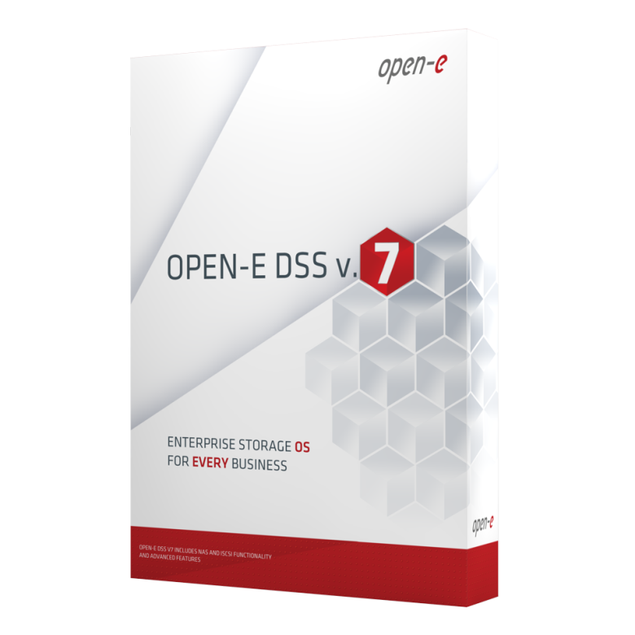
What‘s new?
More changes in the software
Improved Active-Passive Failover functionality
Improved iSCSI Failover Configuration
New improved GUI with Status Icons
Full focus on 64-bit Architecture
New software architecture enabling extended cloud functionality (coming soon)

Slide 13
Let‘s begin!
Your Name

Slide 14
Introduction
to Open-E DSS V7

Slide 15
Installing Open-E DSS V7
(as a VM, RAID and Flash Stick)

Slide 16
Installing Open-E DSS V7
Open-E recommends to install DSS V7 on a SATA DOM, IDE DOM and or a SSD Drive as they have a higher MTBF.
We have found out that many of the USB Flash Sticks have lower life of 4 years and under even with some that have the Wear Leveling support they can Still fail.
RAID
Create a 2GB Volume from the RAID
Create the RAID Array
Make the 2GB volume the 1st boot order
Other capacity amount will be available to be used for the DSS V7 Volume manger

Slide 17
Installing Open-E DSS V7
Virtual Machine
Prepare virtual storage with minimum of 2GB
Configure CPU, Memory and NICs for the VM
Have DSS V7 ISO image available to be installed as a VM (typically via NFS mounts or others)
USB Flash Stick (to be used to install not as the main boot media)
Recommend 2GB or more (please remove all other partitions)
Use Wear Leveling (If possible) USB Flash Sticks or DOMs “Disk on Modules”
Unpack the DSS V7 ZIP version
Format via Fat 16 or 32
Use the “bootinst.exe”
Make USB the 1st boot order

Slide 18
Lab Work
15 minutes to install Open-E DSS V7
as a Virtual Machine

Slide 19
Installing Open-E DSS V7
Other Mediums that can be used
Can be used with Hard Drives, FC Targets (4Gb and 8Gb FC HBA’s), Onboard RAID controllers with RAID 1, SATA DOMs
Additional Information
Defaults to 64 bit mode
Can run Memtest or other troubleshooting methods
If carving out 1 partition for the installation of the DSS V7 you will not be able to use the rest of the capacity
New RAID controllers that require new drivers that are not in the DSS V7 might not install or boot properly
Date 2011, based on Open-E DSS V7

Slide 20
Installing Open-E DSS V7
Additional Information
Entering the Product key in the GUI requires a reboot but not an Online or Offline Activation. You can edit the prod.key file to reduce re-boots
New Volume Group must be created (5GB is the minimum)
Run RAID Array/disk Read and Write speeds speed tests before deploying the system along NIC speeds as well with small updates – providing during the class for future use
If you change or add a CPU, NICs or memory there is no reactivation only with other hardware components
Date 2011, based on Open-E DSS V7

Slide 21
Installing Open-E DSS V7
Additional Information
Existing 32bit volumes needing to switch to 64bit must backup the data and verify before deleting and creating new 64bit Volume Group
Once system has been fully configured with Logical Volumes save your configuration and settings from the GUI in Maint. > Misc, you can restore them from the settigns.cnf if need be in the future
The data on the volumes will always be available if in the event of a power hit or other (except if for RAID issues), just install DSS V7 on another Boot Media (CD-ROM, USB or other)
At the end of the 60 Trial version performance drops from 1GbE to 10/100MB but data is still available
Date 2011, based on Open-E DSS V7

Slide 22
Auto Failover
Active-Active with Open-E DSS V7 (iSCSI) and Active-Passive with Open-E DSS V6 (NFS)

Slide 23
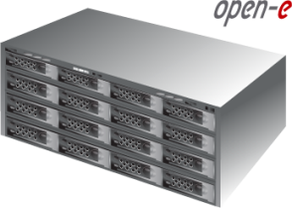
Open-E DSS V7 Active-Active iSCSI Failover
1. Hardware Configuration
Hardware Requirements:
To run the Active-Active iSCSI Failover, two DSS systems are required. Both servers must be located and working in the Local Area Network.
See below configuration settings as an example:
LAN
PING NODES
IP Addresses : 192.168.2.7; 192.168.3.7
Data Server (DSS220)
node-a
IP Address:192.168.0.220
Control
Data Server (DSS221)
node-b
IP Address:192.168.0.221
Switch 1
Switch 2
RAID System 1
RAID System 2
Port used for WEB GUI management
IP:192.168.0.220 eth0
Port used for WEB GUI management
eth0 IP:192.168.0.221
Volume Replication ,
Auxiliary connection (Heartbeat)
IP:192.168.1.220 eth1
Note:
It is strongly recommended to use direct point-to-point (without the switch) connection for the volume replication.
Volume Replication ,
Auxiliary connection (Heartbeat)
eth1 IP:192.168.1.221
Storage Client Access, Auxiliary connection (Heartbeat)
IP:192.168.2.220 eth2
Storage Client Access,
Auxiliary connection (Heartbeat)
eth2 IP:192.168.2.221
Virtual IP Address:
192.168.20.100 (resources pool node-a iSCSI Target0)
Storage Client Access, Auxiliary connection (Heartbeat)
IP:192.168.3.220 eth3
Storage Client Access,
Auxiliary connection (Heartbeat)
eth3 IP:192.168.3.221
Volume Groups (vg00)
Virtual IP Address:
192.168.30.100 (resources pool node-b iSCSI Target1)
Volume Groups (vg00)
iSCSI volumes (lv0000, lv0001)
iSCSI volumes (lv0000, lv0001)
iSCSI targets
iSCSI Failover/Volume Replication (eth1)
iSCSI targets
NOTE:
To prevent switching loops, it's recommended to use RSTP (802.1w) or STP (802.1d) protocol on network switches used to build A-A Failover network topology.

Slide 24
Open-E DSS V7 Active-Active iSCSI Failover
Open-E DSS V7 Active-Active iSCSI Failover
Hardware Configuration with 2 IP virtual addresses on the single NIC
LAN
PING NODES
IP Addresses : 192.168.2.7; 192.168.3.7
Data Server (DSS220)
node-a
IP Address:192.168.0.220
Control
Data Server (DSS221)
node-b
IP Address:192.168.0.221
Switch 1
Switch 2
RAID System 1
RAID System 2
Port used for WEB GUI management
IP:192.168.0.220 eth0
Port used for WEB GUI management
eth0 IP:192.168.0.221
Volume Replication ,
Auxiliary connection (Heartbeat)
IP:192.168.1.220 eth1
Note:
It is strongly recommended to use direct point-to-point (without the switch) connection for the volume replication.
Volume Replication ,
Auxiliary connection (Heartbeat)
eth1 IP:192.168.1.221
Storage Client Access, Auxiliary connection (Heartbeat)
IP:192.168.2.220 eth2
Storage Client Access,
Auxiliary connection (Heartbeat)
eth2 IP:192.168.2.221
Virtual IP Address:
192.168.20.100 (resources pool node-a iSCSI Target0)
Volume Groups (vg00)
Virtual IP Address:
192.168.30.100 (resources pool node-b iSCSI Target1)
Volume Groups (vg00)
iSCSI volumes (lv0000, lv0001)
iSCSI volumes (lv0000, lv0001)
iSCSI Failover/Volume Replication (eth1)
iSCSI targets
iSCSI targets
NOTE:
To prevent switching loops, it's recommended to use RSTP (802.1w) or STP (802.1d) protocol on network switches used to build A-A Failover network topology.

Slide 25
Open-E DSS V7 Active-Active iSCSI Failover
Open-E DSS V7 Active-Active iSCSI Failover
Hardware Configuration with 2 IP virtual addresses on bond.
LAN
PING NODE
IP Address : 192.168.2.7
Data Server (DSS220)
node-a
IP Address:192.168.0.220
Control
Data Server (DSS221)
node-b
IP Address:192.168.0.221
Switch 1
Switch 2
RAID System 1
RAID System 2
Port used for WEB GUI management
IP:192.168.0.220 eth0
Port used for WEB GUI management
eth0 IP:192.168.0.221
Volume Replication ,
Auxiliary connection (Heartbeat)
IP:192.168.1.220 eth1
Note:
It is strongly recommended to use direct point-to-point (without the switch) connection for the volume replication.
Volume Replication ,
Auxiliary connection (Heartbeat)
eth1 IP:192.168.1.221
Storage Client Access, Auxiliary connection (Heartbeat)
bond0 IP:192.168.2.220 (eth2, eth3)
Storage Client Access, Auxiliary connection (Heartbeat)
(eth2, eth3) IP:192.168.2.221 bond0
Virtual IP Address:
192.168.20.100 (resources pool node-a iSCSI Target0)
Volume Groups (vg00)
Virtual IP Address:
192.168.30.100 (resources pool node-b iSCSI Target1)
Volume Groups (vg00)
iSCSI volumes (lv0000, lv0001)
iSCSI volumes (lv0000, lv0001)
iSCSI Failover/Volume Replication (eth1)
iSCSI targets
iSCSI targets
NOTE:
To prevent switching loops, it's recommended to use RSTP (802.1w) or STP (802.1d) protocol on network switches used to build A-A Failover network topology.

Slide 26
Open-E DSS V7 Active-Active iSCSI Failover
Storage client
Multipath I/O with Activ-Activ iSCSI Failover.
IP:192.168.10.231 eth0
IP:192.168.21.231
IP:192.168.22.231
eth2 (MPIO)
PING NODES
IP Addresses : 192.168.12.107, 192.168.13.107
IP:192.168.31.231 IP:192.168.32.231
eth3 (MPIO)
LAN
Control
Data Server (DSS1)
node-a
IP Address:192.168.10.220
Data Server (DSS2)
node-b
IP Address:192.168.10.221
Switch 1
Switch 2
RAID System 1
RAID System 2
Port used for WEB GUI management
IP:192.168.10.220 eth0
Port used for WEB GUI management
eth0 IP:192.168.10.221
Volume Replication ,
Auxiliary connection (Heartbeat)
IP:192.168.11.220 eth1
Note:
It is strongly recommended to use direct point-to-point (without the switch) connection for the volume replication.
Volume Replication ,
Auxiliary connection (Heartbeat)
eth1 IP:192.168.11.221
Storage Client Access, Multipath
Auxiliary connection (Heartbeat)
IP:192.168.12.220 eth2
Storage Client Access, Multipath,
Auxiliary connection (Heartbeat)
eth2 IP:192.168.12.221
Storage Client Access, Multipath
Auxiliary connection (Heartbeat)
IP:192.168.13.220 eth3
Resources Pools and Virtual IP Addresses:
Node-a 192.168.21.100; iSCSI Target 0
Node-b 192.168.22.100; iSCSI Target 1
Storage Client Access, Multipath
Auxiliary connection (Heartbeat)
eth3 IP:192.168.13.221
Volume Groups (vg00)
Resources Pools and Virtual IP Addresses:
Node-a 192.168.31.100; iSCSI Target 0
Node-b 192.168.32.100; iSCSI Target 1
Volume Groups (vg00)
iSCSI volumes (lv0000, lv0001)
iSCSI Failover/Volume Replication (eth1)
iSCSI volumes (lv0000, lv0001)
iSCSI targets
iSCSI targets
NOTE:
To prevent switching loops, it's recommended to use RSTP (802.1w) or STP (802.1d) protocol on network switches used to build A-A Failover network topology.

Slide 27
Open-E DSS V7 with Multipath Active-Active iSCSI Failover
Storage client 1
1. Hardware Configuration
Storage client 2
IP:192.168.0.101 eth0
eth0 IP:192.168.0.102
IP:192.168.21.101
IP:192.168.22.101
eth2 (MPIO)
eth2 (MPIO)
IP:192.168.21.102
IP:192.168.22.102
IP:192.168.31.101 IP:192.168.32.101
eth3 (MPIO)
PING NODES
IP Addresses : 192.168.1.107,
192.168.2.107
eth3 (MPIO)
IP:192.168.31.102 IP:192.168.32.102
Data Server (DSS1)
node-a
IP Address:192.168.0.220
Data Server (DSS2)
node-b
IP Address:192.168.0.221
Switch 1
Switch 2
RAID System 1
RSTP/Port Trunk
RAID System 2
Port used for WEB GUI management
IP:192.168.0.220 eth0
Note:
Please use external tool to monitor failures in connections between switches.
Port used for WEB GUI management
eth0 IP:192.168.0.221
Storage Client Access, Multipath
Auxiliary connection (Heartbeat)
bond0 IP:192.168.1.220 (eth1, eth2)
Storage Client Access, Multipath
Auxiliary connection (Heartbeat)
(eth1, eth2) IP:192.168.1.221 bond0
Resources Pools and Virtual IP Addresses:
Node-a 192.168.21.100; iSCSI Target 0
Node-b 192.168.22.100; iSCSI Target 1
Storage Client Access, Multipath
Auxiliary connection (Heartbeat)
bond1 IP:192.168.2.220 (eth3, eth4)
Storage Client Access, Multipath,
Auxiliary connection (Heartbeat)
(eth3, eth4) IP:192.168.2.221 bond1
Volume Replication,
Auxilliary connection (Heartbeat)
IP:192.168.5.220 eth5
Resources Pools and Virtual IP Addresses:
Node-a 192.168.31.100; iSCSI Target 0
Node-b 192.168.32.100; iSCSI Target 1
Volume Replication ,
Auxilliary connection (Heartbeat)
eth5 IP:192.168.5.221
Note:
It is strongly recommended to use direct point-to-point and if possible 10Gb connection for the volume replication. Optionally Round-Robin-Bonding with 1Gb or 10Gb ports can be configured for the volume replication. The volume replication connection can work over the switch, but the most reliable is a direct connection.
Volume Groups (vg00)
Volume Groups (vg00)
iSCSI volumes (lv0000, lv0001)
iSCSI volumes (lv0000, lv0001)
iSCSI targets
iSCSI Failover/Volume Replication (eth5)
iSCSI targets
NOTE:
To prevent switching loops, it's recommended to use RSTP (802.1w) or Port Trunking on network switches used to build A-A Failover network topology.

Slide 28
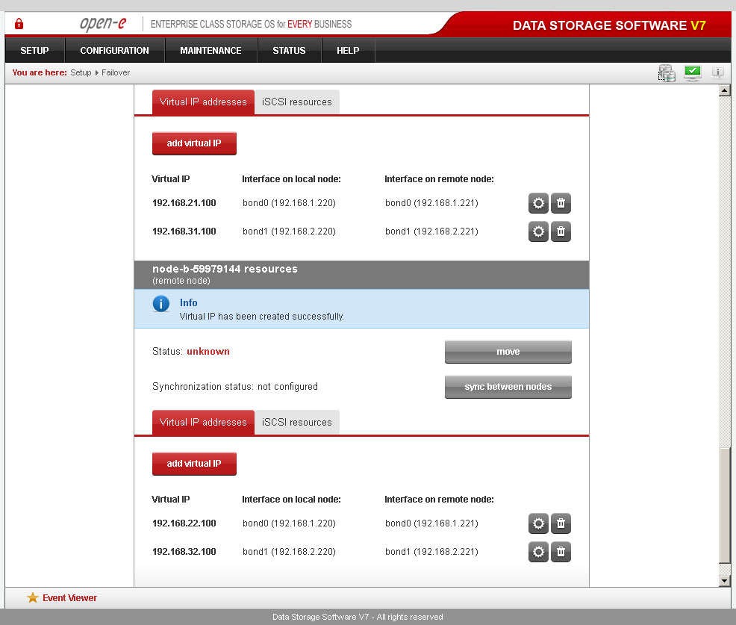
Open-E DSS V7 with Multipath Active-Active iSCSI Failover
Data Server (DSS1)
node-a
IP Address:192.168.0.220
6. Configure Failover
Now you have 4 Virtual IP addresses configured on two interfaces.

Slide 29
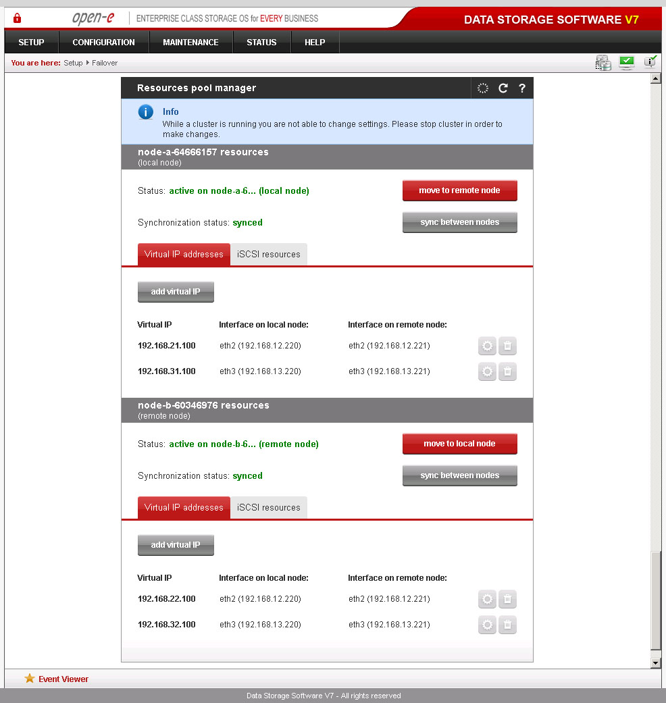
Open-E DSS V7 Active-Active iSCSI Failover

Slide 30
Data Replication

Slide 31
Asynchronous Data Replication within a System
Configure hardware
Hardware Requirements
To run the data replication on Open-E DSS V7, a minimum of two RAID arrays are required on one system. Logical volumes working on RAID Array 1 must have snapshots created and enabled. An example configuration is shown below:
Data Server (DSS230)
IP Address:192.168.0.230
RAID Array 1
Primary
RAID Array 2
Secondary
Volume Groups (vg00)
Volume Groups (vg01)
Snapshot (snap0000)
NAS volume (lv0000)
NAS volume (lv01000)
Shares: Data
Shares: Copy of Data
Data Replication

Slide 32
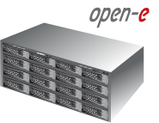
Asynchronous Data Replication over a LAN
Configure hardware
Hardware Requirements
To run the data replication on Open-E DSS V7 over LAN, a minimum of two systems are required. Logical volumes working on source node must have snapshots created and enabled. Both servers are working in the Local Area Network. An example configuration is shown below:
Data Server (DSS230)
Source node
IP Address: 192.168.0.230
Data Server (DSS240)
Destination node
IP Address: 192.168.0.240
RAID System 1
Primary
RAID System 2
Secondary
Volume Groups (vg00)
Volume Groups (vg00)
Snapshot
NAS volume (lv0000)
NAS volume (lv0000)
Shares: Data
Shares: Copy of Data
Data Replication

Slide 33
Asynchronous Data Replication over a LAN / WAN
Data Replication: one-to-many
Data Replication
…

Slide 34
Asynchronous Data Replication over a LAN / WAN
Data Replication: many-to-one
Data Replication
…
…

Slide 35
Snapshots and Backup

Slide 36
Snapshots
What is Snapshot?
Allows you to create a new block device which presents an exact copy of a logical volume, frozen at some point in time, so overall it is based on the Logical Volume Manager
This provides access to the data existing on the volume at the snapshot start time
The original copy of the data continues to be available to the users without interruption, while the snapshot copy is used to perform other functions on the data for Backup and Data Replication applications or user access point in time data to access accidentally deleted or modified files for FC, iSCSI and FC Volumes
A Snapshot created in one Volume Group cannot be used in a different Volume Group
Please keep assigned Snapshots separate for there tasks, try to keep a designated Snapshot for each task or create additional Snapshots
Date 2011, based on Open-E DSS V7

Slide 37
Snapshots
Basic Explanation of Snapshot and Known Conditions
Concurrent snapshots can be performed but we recommend to have no more then 10 per Logical Volume and no more then 20 actively on at the same time per system
Deleted data is claimed as free space in a “live” volume mount, but in reality the deleted data is still available in the snapshot mount
Starting or stopping a snapshot is very fast, this only takes a few seconds even for large amount of data
Writing speed decreases with growing number of active snapshots (because of copy-on-write)
The size of the reserved space for snapshot depends on the amount of changed data while the snapshot is active.
Daily scheduled snapshots will need less reserved space then weekly scheduled snapshot. The size of the
Snapshot should be 2 or 3 times the size of the expected changes for the data
Date 2011, based on Open-E DSS V7

Slide 38
Snapshots
How to access Snapshots for NAS Volumes
Go to the CONFIGURATION -> NAS settings menu and select the network protocol on which the snapshots will be accessible. You can activate access to snapshots on the following protocols:
NFS, SMB(Network neighborhood), FTP, AFP.
Create a new share that will be assigned to the activated snapshot,
Go to the CONFIGURATION -> NAS resources menu,
Within the Create new share function:
Enter share name, use the Specified path option and select the snapshot that
you want to have access to
Click Apply to create a share, now you can start to explore your share(snapshot) using the specified network protocol
Date 2011, based on Open-E DSS V7

Slide 39
Snapshots
How to access Snapshots for iSCSI Volumes
(Similar to FC Volumes)
Go to the CONFIGURATION -> iSCSI target manager -> Targets -> [target_name] menu,
Enter the Target volume manger function and click the Add button on the right side of the. A new LUN will be added to the target CONFIGURATION -> FC target manager -> Groups -> [Group_name] -> Function: Add group volumes
Date 2011, based on Open-E DSS V7

Slide 40
Backup
The Built-in Backup function provides reliable backups
for NAS Volumes – this is how it works:
Backup only is designed for NAS Logical Volumes (FC and iSCSI volumes are not supported)
The Backup function needs a Snapshot in order to create the Task
The Shares are backed up from the NAS Logical Volumes
Backup has a higher priority then Data Replication if scheduled at the same time
Supported backup types Full (All data on every backup task), Differential (new data from last Full Backup) and Incremental (only backs up new data)
Can perform compression (depending on hardware and file structure)
Must have its own Backup database without existing files in the NAS Share’s
NAS WORM volumes cant be backed up
Usage of Pools used for grouping Tapes or Virtual Taps
Task scheduled to set time values for your backups
Restore feature for backups to restore data to any NAS Share
Date 2011, based on Open-E DSS V7

Slide 41
Backup
Mediums that you can Backup to
Backup to a Tape Library & Drive, RAID controller, RAID array
Backup to a Dynamic Volume with - USB drive, SATA drive, ATA drive
Backup to iSCSI Target Volume, FC Target Volume
Date 2011, based on Open-E DSS V7

Slide 42
Multipath vs. Bonding
and MPIO with VMware and Windows

Slide 43
Bonding vs. MPIO
Setup Chart: http://blog.open-e.com/bonding-versus-mpio-explained
http://blog.open-e.com/ping-node-explained/
Bonding types, LACP
Multipath: target and initiator

Slide 44
MPIO with VMware and Microsoft
Setup Chart: http://blog.open-e.com/ping-node-explained/
Step-by-step: http://www.open-e.com/library/how-to-resources

Slide 45
Understanding Logs

Slide 46
Understanding Logs
DSS V7 system logs and why do we need them?
The logs contain information of the DSS V7 system and help to trouble shoot issues.
They provide information on how the system behaves and point to bottlenecks in order to make some tunings.
How to download the DSS V7 logs?
They are downloadable via WebGUI → Status → Hardware → Logs
Generation of system logs can take up to few minutes
They are compressed with gzip and tarball. They can be unpacked using 7zip or WinRAR
Date 2011, based on Open-E DSS V7

Slide 47
Understanding Logs
What is in the DSS V7 system logs?
Crucial system services, Configuration of system services, Read performance of attached disks and RAID units.
Information about currently running system tasks with their exit codes (i.e. Data Replication, Snapshots).
The DSS V7 system logs do not include any kind of information of the stored data on its storage for FC, iSCSI and NAS
Most viewed logs from the support team: critical_error, dmesg2, test, Samba, iSCSI, ha_debug…
Date 2011, based on Open-E DSS V7

Slide 48
Understanding Logs
What is the critical_errors.log file?
It includes all information that could be found in the event viewer (WebGUI).
It includes timestamps of logged events.
The DSS V7 uses syslog and smart expressions for filtering messages
Configure the DSS V7 Email to receive email alerts
Date 2011, based on Open-E DSS V7

Slide 49
Understanding Logs
What is it the dmesg?
The dmesg displays the contents of the system message buffer.
Each device driver present in the kernel probes the system for the existence of relevant hardware. If the hardware is located, a diagnostic message is produced documenting precisely what was found.
It can detect a so called I/O errors of attached disks and RAID units.
Date 2011, based on Open-E DSS V7

Slide 50
Understanding Logs
What’s in the tests.log file?
It is divided into sections that are named respectively to the command that generated the output from the internal self- test command
It includes:
Information's from sysfs and procfs
Benchmark results of read performance of disks and RAID units
Output of some other commands (apcacces status, net ads info and so on)
Can find RAID controllers firmware (also can be found in the dmesg log)
Date 2011, based on Open-E DSS V7

Slide 51
Understanding Logs
What‘s in the Samba logs?
It is placed in „/samba“ directory in logs package.
It includes log output of 3 main Samba processes (smbd, nmbda and windbind).
It includes basic level information of each established connection (log's name can be log.ip_address in case of the connection is established with IP or log.server_name in case the connection is established using NetBios name).
Date 2011, based on Open-E DSS V7

Slide 52
Understanding Logs
Example of RAID unit/disk I/O errors
sdb: rw=0, want=4294967052, limit=2429794304
Buffer I/O error on device sdb, logical block 1073741761
CCISS controler /dev/cciss/c0d0 reported: Parity/consistency initialization complete, logical drive 1 reading directory #81961 offset 0<3>sd 1:0:0:0: rejecting I/O to offline device
Date 2011, based on Open-E DSS V7

Slide 53
Understanding Logs
Example of file system errors
journal commit I/O error
Call Trace:
[<ffffffff80395792>] xfs_alloc_ag_vextent_near+0x512/0x980
[<ffffffff80393b87>] xfs_alloc_fixup_trees+0x317/0x3b0
[<ffffffff803ad9bd>] xfs_btree_setbuf+0x2d/0xc0[<ffffffff80395792>] xfs_alloc_ag_vextent_near+0x512/0x980
[<ffffffff80395cd5>] xfs_alloc_ag_vextent+0xd5/0x160
[<ffffffff80396546>] xfs_alloc_vextent+0x256/0x470
[<ffffffff803a7865>] xfs_bmap_btalloc+0x475/0xa50
[<ffffffff803a827a>] xfs_bmapi+0x41a/0x12a0
[<ffffffff80271713>] mempool_alloc+0x43/0x120
Date 2011, based on Open-E DSS V7

Slide 54
Understanding Logs
test.log/ethtool (Bad Packets)
eth1 Link encap:Ethernet HWaddr 00:25:90:21:38:43
inet addr:192.168.1.220 Bcast:192.168.1.255 Mask:255.255.255.0
UP BROADCAST MULTICAST MTU:1500 Metric:1
RX packets:0 errors:0 dropped:5689 overruns:0 frame:0
TX packets:0 errors:0 dropped:0 overruns:0 carrier:0
collisions:0 txqueuelen:1000
Date 2011, based on Open-E DSS V7

Slide 55
Understanding Logs
test.log /ethtool (NIC Speed)
Supported link modes: 10baseT/Half 10baseT/Full
100baseT/Half 100baseT/Full
1000baseT/Full
Supports auto-negotiation: Yes
Advertised link modes: 10baseT/Half 10baseT/Full
100baseT/Half 100baseT/Full
1000baseT/Full
Advertised auto-negotiation: Yes
Speed: 100Mb/s
Duplex: Full
Port: Twisted Pair
PHYAD: 1
Date 2011, based on Open-E DSS V7

Slide 56
Understanding Logs
Example of poor performance
The system has poor write performance in the dmesg log we can find:
sd 1:2:0:0: [sdb] Very big device. Trying to use READ CAPACITY(16).
sd 1:2:0:0: [sdb] 8779857920 512-byte hardware sectors (4495287 MB)
sd 1:2:0:0: [sdb] Write Protect is off
sd 1:2:0:0: [sdb] Mode Sense: 1f 00 10 08
sd 1:2:0:0: [sdb] Write cache: disabled, read cache: enabled, supports DPO and FUA
sd 1:2:0:0: [sdb] Very big device. Trying to use READ CAPACITY(16).
sd 1:2:0:0: [sdb] 8779857920 512-byte hardware sectors (4495287 MB)
sd 1:2:0:0: [sdb] Write Protect is off
sd 1:2:0:0: [sdb] Mode Sense: 1f 00 10 08
sd 1:2:0:0: [sdb] Write cache: disabled, read cache: enabled, supports DPO and FUA
Date 2011, based on Open-E DSS V7

Slide 57
Understanding Logs
Example of connection issues with an ADS domain
Cannot renew kerberos ticket
Time skew is greater than 5 minutes
[2011/07/04 14:29:31.495026, 0] utils/net_ads.c:285(ads_startup_int)
ads_connect: No logon servers
Didn't find the ldap server!
Date 2011, based on Open-E DSS V7

Slide 58
Auto Failover Active-Active
with Open-E DSS V7 (iSCSI), Zero-single-Point-of-Failure setup and best practices

Slide 59
Agenda
OECE Training – Day 2
Q & A Session with Lab Work
Certification Exam – theoretical (45 Minutes)
Certification Exam – practical (60 minutes)
Pre-Sales, Support Infrastructure and Best Practices

Slide 60
Q & A Session with Lab Work

Slide 61
Certification Exam theoretical
(45 Minutes)

Slide 62
Certification Exam practical
(60 minutes)

Slide 63
Pre-Sales, Support Infrastructure and Best Practices

Slide 64
Best Practices
Keep your data redundant
NOTE: Never start production without any data backup plan.
For mission-critical (very expensive) data:
Mandatory: perform periodical data backups (incremental archiving) with DSS V7 built-in backup,
or with a third-party backup appliance (e.g. Backup Exec) via a built-in agent.
Optional: additionally run data replication periodically, with frequency according to application
needs.
For non-critical data:
Mandatory: run at least data replication periodically, with frequency according to application needs.
Optional: additionally perform periodical data backups, with frequency according to application
needs.
NOTE: RAID arrays are NOT to be considered as a data backup. RAID does not provide real data redundancy, it merely prevents a loss of data availability in the case of a drive failure. Never use RAID 0 in a production system - instead, use redundant RAID levels, such as 1, 5, 6 or 10. A single drive failure within a RAID 0 array will inherently result in data loss, which will require restoration of the lost data from a backup.

Slide 65
Best Practices
Check hardware health
Before starting the system in full production, create a 10GB iSCSI volume in File-I/O mode (with initialization). On a regular RAID array, a 10GB volume should be created and initialized in approximately 110 seconds. Optional: create a 100GB iSCSI File-I/O volume (with initialization and medium speed). On a regular RAID array, a 100GB volume should be created and initialized in approximately 15 minutes.
Delete the created 10GB (and/or 100GB) volume.
Create a new iSCSI File-I/O volume (with initialization) using ALL free space.
After the iSCSI volume spanning all available space has been initialized, reboot the system.
After the reboot, check the event viewer for errors - the event viewer must be free of any errors.
If event viewer is clean, delete the test iSCSI volume.
Create new volumes as required, and start production.
Optional: Once system temperature becomes stable, perform measurements to check whether it remains within a range allowed for your system components.

Slide 66
Best Practices
Check hardware RAID
IMPORTANT NOTE: Make sure that the hard disk trays are labeled correctly with their properport numbers. Errors in labeling of the disk trays may result in pulling out wrong drive. Be aware that the port count may start with 0 on some RAID controllers, and with 1 on others.
Before starting the production system, create and initialize the RAID array; also, configure email notifications in the RAID controller GUI (and/or in the DSS GUI).
Create a 100GB iSCSI volume in File-I/O mode (with initialization), and during the iSCSI initialization process REMOVE a hard disk from the RAID array.
Check the event viewer for errors. There must be entries informing about the array now being degraded; however, there must be NO reported I/O errors, as the degraded state must be transparent to the OS.
Now, re-insert the drive. It is likely that partial logical volume data, as well as partial RAID metadata will still reside on the drive; in most cases, this residual partial data must be deleted before a rebuild can be started.

Slide 67
Best Practices
DEGRADED RAID (as a result of a drive failure)
Before starting the production system, create and initialize the RAID array; also, configure
Run a full data backup.
Verify the backed-up data for consistency, and verify whether the data restore mechanism works.
Identify the problem source, i.e. find the erroneous hard disk. If possible, shut down the server, and make sure the serial number of the hard disk matches that reported by the RAID controller.
Replace the hard disk identified as bad with a new, unused one. If the replacement hard drive had already been used within another RAID array, make sure that any residue RAID metadata on it has been deleted via the original RAID controller.
Start RAID the rebuild.
IMPORTANT NOTE: Never use hot-spare hard disks, as a hot-spare hard disk will jump in automatically,
and the array will start rebuilding immediately. A RAID rebuild is a heavy-duty task, and the probability of
another drive failure during this process is higher than usual; thus, it is a best practice to start the rebuild
in step 5 rather than immediately.

Slide 68
Best Practices
iSCSI and FC Volumes
iSCSI and FC volumes emulate a raw SCSI drive; in the case they will be partitioned and formatted with a regular (non-cluster) file system like NTFS, EXT3, XFS, etc., they must be used by a host exclusively. The I/O of an iSCSI target is block-based (as opposed to file-based), which means that changes made by one person will not be seen by another person working on the same target/volume.
An iSCSI/FC volume usually represents a slice of a RAID disk array, often allocated one per client. iSCSI/FC imposes no rules or restrictions on multiple computers sharing an individual volume. It leaves shared access to a single underlying file system as a task for the operating system.
WARNING: If two or more hosts using a non-cluster file system write to the same target/volume, the file
system will crash, which will more than likely result in data loss. In order to make more concurrent
connections to the same target practically possible, utilization of a special SAN file system like GFS,
OCSF etc. is required.

Slide 69
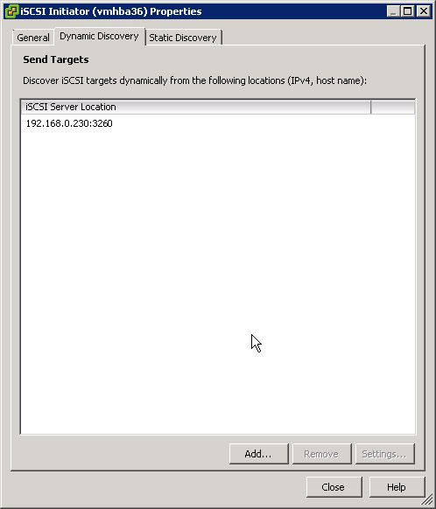
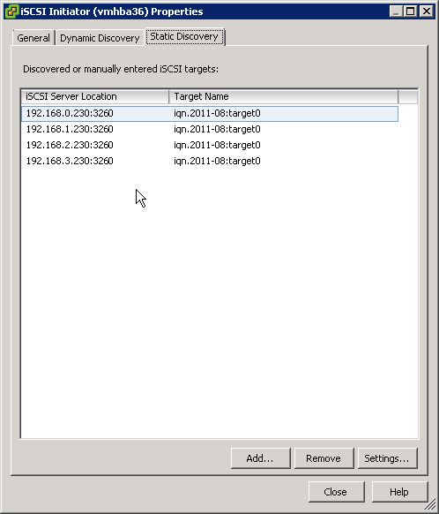
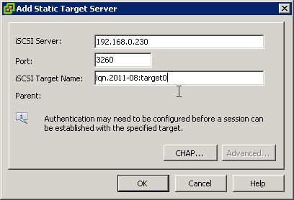
Best Practices
Static vs. Dynamic Discovery in VMware

Slide 70
Best Practices
Multi-Storage Units System
Create a separate volume group for every external storage unit. This is a good practice, as such a configuration proves to be more reliable: in case one of the units has a problem, the others can continue to work.
If the application requires the addition of external storage units into the same volume group, make sure the connections are very reliable, as ALL of the storage will become unavailable if only one of the units is missing.

Slide 71
Best Practices
How To Install Open-E Data Storage Software V7
NOTE: Never start production without any data backup plan.
With hardware RAID:
It is recommended to create a 2GB-sized logical unit for DSS V7, and a second logical unit spanning all of the remaining space for the user data.
NOTE: RAID controllers do not support creating more than one logical unit from within the controller BIOS.
For example, the HP Smart Array needs to be booted from a Smart Array Management CD in order to be
able to create a RAID array with multiple logical units. Please refer to your RAID controller user manual.
With software RAID:
It is required to install DSS V7 on a separate boot media. Please use boot media like a HDD, a SATA-DOM, or an IDE-DOM. Please DO NOT use USB-DOM for production.

Slide 72
Best Practices
Volume size and RAM
Avoid creating volumes larger than 64TB;
It is recommended to install an amount of RAM calculated in the following way:
(Size of RAM to install in GB) = (Size of the largest volume in TB) / 2
For example: if the size of the largest volume is 32TB, the recommended
amount of RAM is 16GB.

Slide 73
Best Practices
System Temperature
Generally, high temperatures will shorten the lifespan of hard disks, thus try to use hard disks with
an operation temperature as low as possible.
BeTIP: In order to estimate the temperature levels the hard drives within your system may reach during daily operation, you can connect drives into SATA ports on the motherboard, create a NAS or iSCSI volume in DSS, and then run any random pattern test.
In the case your hard disks are connected to the mainboard SATA controller, you can monitor the temperature of these hard disks from within the DSS GUI (STATUS -> S.M.A.R.T.). For this functionality to be available, make sure that S.M.A.R.T has been enabled in the BIOS setup of your system's motherboard, as well as in the DSS console (press Ctrl-Alt-W in the console to enter Hardware Configuration, then navigate Functionality Options -> enable S.M.A.R.T).
If you are using a RAID controller, please refer to its user manual to find information on how to monitor hard disk temperatures. Some RAID controllers do support such functionality, while others don't.

Slide 74
Best Practices
System Chassis, Vibrations, Raid Port Labeling
In order to avoid unexpected vibrations, always try to use hard disks with the same RPM spindle speed. Should you be forced to mix 7200, 10,000, and/or 15,000 RPM drives, please use drives with anti-vibration firmware, and make sure that the hard disks' and chassis' vendors declare support for utilization in such an environment (which is not to be assumed without prior verification).

Slide 75
Pre-Sales, Support, Best Practices
Pre-Sales (pre-sales@open-e.com)
Specifically used for inquiring about new features or drivers or hardware certification
Is not used for technical support
Can be used for requesting information about the product – “Can the DSS V7 work as a Virtual Machine”
Please use when you have an opportunity that you want to verify or quantify before your customers purchase
Support Infrastructure
Register all DSS V7 products
All support cases need to be entered from your User Portal
Date 2011, based on Open-E DSS V7

Slide 76
Pre-Sales, Support, Best Practices
Support Infrastructure
Premium vs Standard Support
Use the Forum and Knowledge Base articles for additional references, use the Open-E “Search” function
Hardware Compatibility List on what we support, though newer hardware may not be listed it is due to the fact that we do not have them in our labs to test but drivers could be the same or just a small update
Use the DSS V7 Trial version, it is the full version and allows you to use this for 60 days, after this time period the system will throttle down to a low speed but data is still accessible or you can delete the volume
Date 2011, based on Open-E DSS V7

Slide 77
Pre-Sales, Support, Best Practices
Support Infrastructure
Read the Release notes! Make sure that you enable the “Subscriptions” tab to receive the updates for DSS V7
Best Practices and Useful information
Take advantage of the “Solutions, How to resources and the Webcasts and video’s”
http://blog.open-e.com/ “Random vs. Sequential explained”, “Just how important is write cache?”, “A Few practical tips about Iometer” and “Bonding versus MPIO explained”….
Date 2011, based on Open-E DSS V7

Slide 78
Pre-Sales, Support, Best Practices
Open-E DSS V7 Updates
We recommend to have at least one release behind the current version
Builds older then 5217 should be updated
Issues with older builds like 4622 “Low memory….” that you have encountered must be updated to prevent this. Even if it has been running perfect for a period of time it is very hard to tell when this will happen and hard for support to determine how to prevent this issue and best to schedule downtime to update.
If using the iSCSI Auto Failover feature update the Secondary first then restore the connection then Failover and update the Primary then once online then Sync from the Secondary to the Primary and then use the Failback feature.
Date 2011, based on Open-E DSS V7

Slide 79
Pre-Sales, Support, Best Practices
IMPORTANT NOTE: In case you experience a problem with the availability of iSCSI / FC volumes after the upgrade from version <= 4622, please change the Identification Device (VPD) compatibility to SCST 1.0.
Run this from the Console:
(CTRL+ALT+W -> Tuning options -> SCST subsystem options -> Device Identification (VPD) compatibility -> SCST).
Important notes regarding updating a system with failover in use:
* In case of using VMware ESX(i) or MS Hyper-V Initiator system, you need to change the Identification Device (VPD) compatibility to SCST 1.0 on the secondary node. This is located in the Console tools (CTRL+ALT+W -> Tuning options -> SCST subsystem options -> Device Identification (VPD) compatibility -> SCST VPD)
- Then once the Secondary is running click on the start button in the Failover manager.
Now update the Primary system using the software update functionality and reboot.
* In case of using VMware ESX(i) or MS Hyper-V as Initiator system, change the Identification Device (VPD) compatibility to SCST 1.0 on the Primary node. This is located in the Console tools (CTRL+ALT+W-> Tuning options -> SCST subsystem options -> Device Identification (VPD) compatibility -> SCST VPD)
- Once the Primary is running go to the Secondary and click on the Sync volumes button in the Failover manager.
- Then click on the Failback button in the Secondary system.
- The Primary system now be go back to the active mode and ready for another failover.
Date 2011, based on Open-E DSS V7

Slide 80
Thank you!
Follow Open-E:

